Slide 1
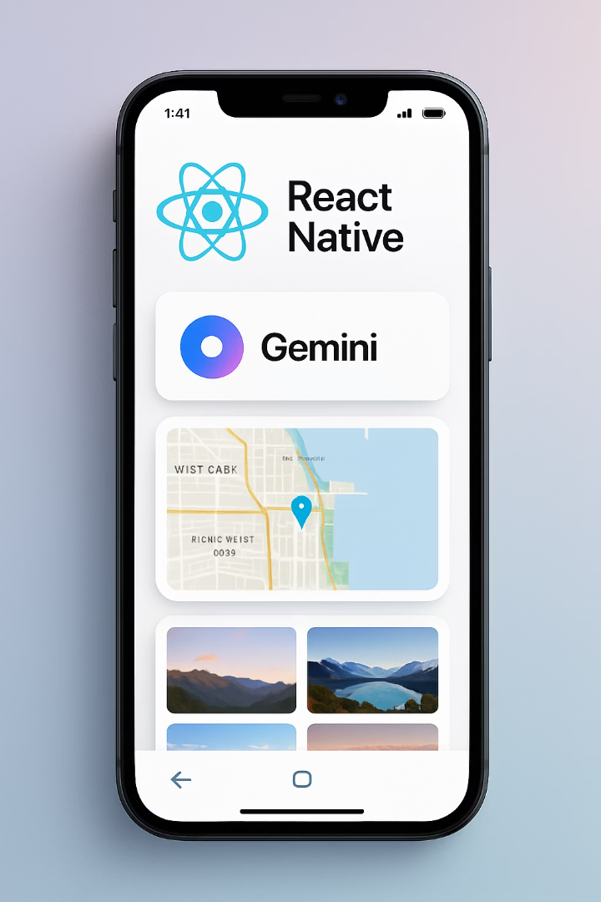
Integrating Advanced Features into Your Expo App
Welcome to this comprehensive guide on integrating powerful features into your Expo application. Throughout this presentation, we'll explore how to enhance your React Native app with Gemini AI for intelligent interactions, Maps for location-based services, and Image Picker for media handling.
These integrations will elevate your app's capabilities, providing users with sophisticated functionality while maintaining the development simplicity that Expo offers. Let's dive into these implementations and transform your application into a feature-rich experience.

Slide 2





Understanding Expo's Integration Ecosystem
Modular Architecture
Simplified Implementation
Expo's framework enables seamless integration of third-party services through Expo modules and SDK packages
Reduces complex native code requirements through abstracted JavaScript APIs
Managed & Bare Workflows
Versioning Compatibility
Integration approaches vary depending on your Expo project configuration
SDK versions determine available integration features and required implementation methods

Slide 3






Getting Started with Expo Project Setup
Initialize Project
Create a new Expo project or use existing one
npx create-expo-app my-feature-rich-app
Install Dependencies
Add required packages for integrations
npx expo install expo-dev-client
Configure Development Build
Set up for native module support
npx expo prebuild
Test Environment
Run on development client for native module testing
npx expo run:android
or
npx expo run:ios

Slide 4



Introduction to Gemini AI
Google's multimodal AI model
Advanced language and vision capabilities
Conversational interfaces
Natural dialog and contextual understanding
Visual content analysis
Image interpretation and generation
Gemini AI represents Google's most advanced AI system, capable of understanding and generating text, images, and multimodal content. By integrating Gemini into your Expo app, you can provide users with intelligent assistants, content generators, and data analyzers that operate directly within your application's interface.

Slide 5
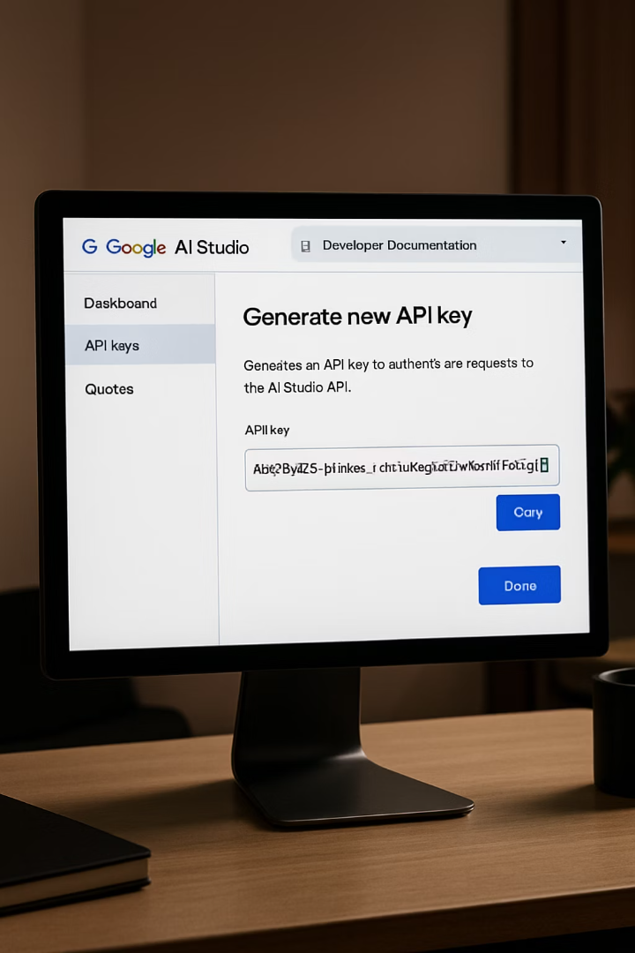
Setting Up Gemini AI Developer Access
Create Google AI Studio Account
Register at ai.google.dev to access the Gemini API. This platform provides the development tools and documentation needed to implement Gemini's capabilities into your application.
Generate API Key
Navigate to the API section and create a new API key. This unique identifier will authenticate your application's requests to the Gemini service. Store this securely and never expose it in client-side code.
Configure API Permissions
Set appropriate usage limits and specify which Gemini models your application will access. This ensures your integration operates within your planned resource allocation and security parameters.

Slide 6
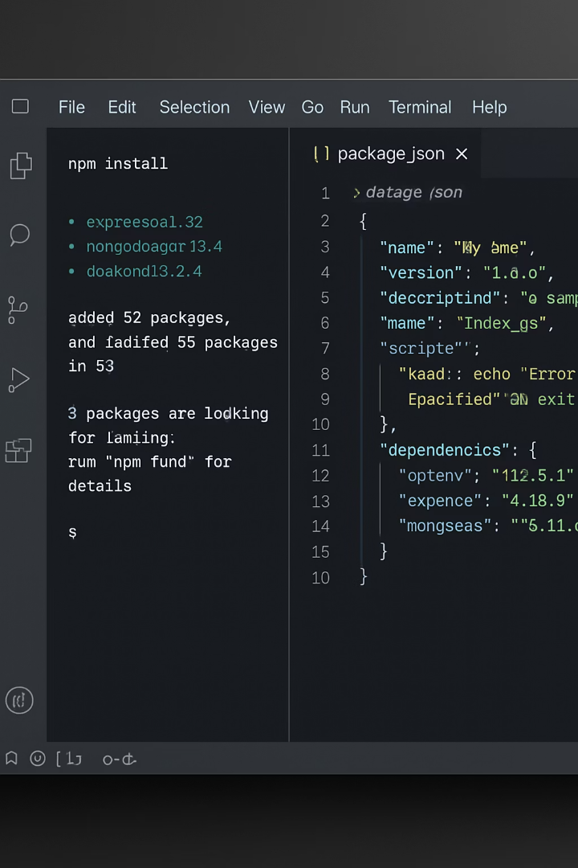
Installing Gemini AI Package in Expo
Install Google AI SDK
Install Environment Config
Open terminal in project directory
Run: npm install react-native-dotenv
Run: npm install @google/generative-ai
Create .env file for API key storage
Verify installation in package.json
Add to .gitignore for security
Configure Babel for Env Variables
Modify babel.config.js file
Add dotenv plugin configuration
Restart development server

Slide 7








Creating a Gemini AI Service in Your App
Create Services Directory
Initialize Gemini Client
Organize API integrations in dedicated folder
Configure API with authentication
Define AI Methods
Export Service Module
Create wrapper functions for different capabilities
Make available throughout your app
A well-structured AI service module centralizes your Gemini implementation, making it easier to maintain and update. This approach also allows you to implement proper error handling, request throttling, and response caching to optimize performance and user experience.

Slide 8
Building a Text Conversation Component with Gemini
Component Structure
Implementation Steps
// GeminiChat.js
import React, { useState } from 'react';
import { View, TextInput, Button } from 'react-native';
import { geminiService } from '../services';
export const GeminiChat = () => {
const [prompt, setPrompt] = useState('');
const [response, setResponse] = useState('');
const [loading, setLoading] = useState(false);
const generateResponse = async () => {
setLoading(true);
try {
const result = await geminiService
.generateText(prompt);
setResponse(result);
} catch (error) {
console.error(error);
} finally {
setLoading(false);
}
};
// Render UI...
};
Create a new React component file
Import the Gemini service
Implement state management for user input
Add function to call Gemini API
Create input field and button UI
Display response with loading states
Handle potential errors gracefully
Implement conversation history (optional)

Slide 9








Implementing Image Analysis with Gemini
Image Selection
Use Expo ImagePicker to select photos
Image Encoding
Convert to base64 format for API
Gemini Processing
Send to multimodal endpoint
Response Display
Show analysis results to user
Gemini's multimodal capabilities allow your app to analyze user-submitted images and provide intelligent descriptions, object detection, or contextual information. This feature can power accessibility tools, content moderation systems, or educational applications within your Expo project.

Slide 10





Enhancing User Experience with Gemini Features
Real-time Translation
Content Summarization
Code Generation
Creative Writing
Allow developers to generate code snippets directly within your app by describing functionality in natural language, creating a powerful development assistant.
Enable users to generate stories, poems, or marketing copy based on prompts, turning your app into a creative writing partner.
Implement multilingual support by processing user text through Gemini's language translation capabilities, allowing your app to break language barriers instantly.
Process long text content to generate concise summaries, helping users quickly understand key information without reading extensive material.

Slide 11
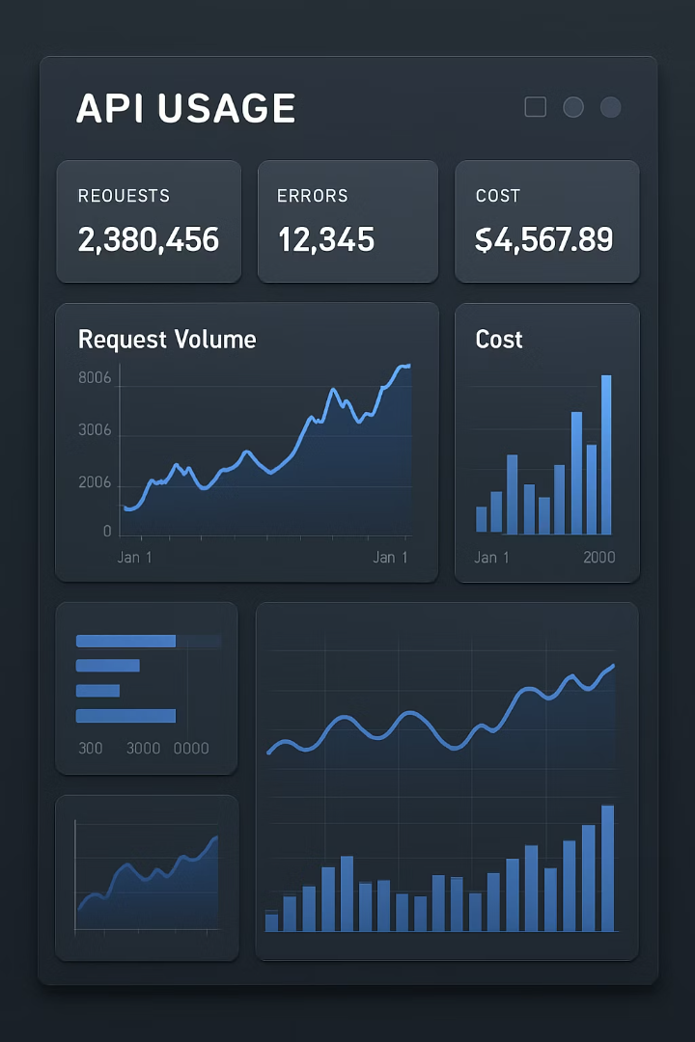
Handling Gemini API Rate Limits and Costs
API Tier
Request Limit
Cost Structure
Best Practices
Free Tier
60 requests/minute
No charge up to quota
Implement client-side throttling
Paid Tier
Custom limits
Per-request pricing
Monitor usage metrics
Enterprise
Negotiable
Volume discount
Implement caching strategies
Effective management of API usage is critical for both application performance and cost control. Implement client-side request batching, response caching, and user quotas to optimize your Gemini integration. Consider implementing a proxy server that handles rate limiting and caching to prevent exposing your API key in client-side code.

Slide 12
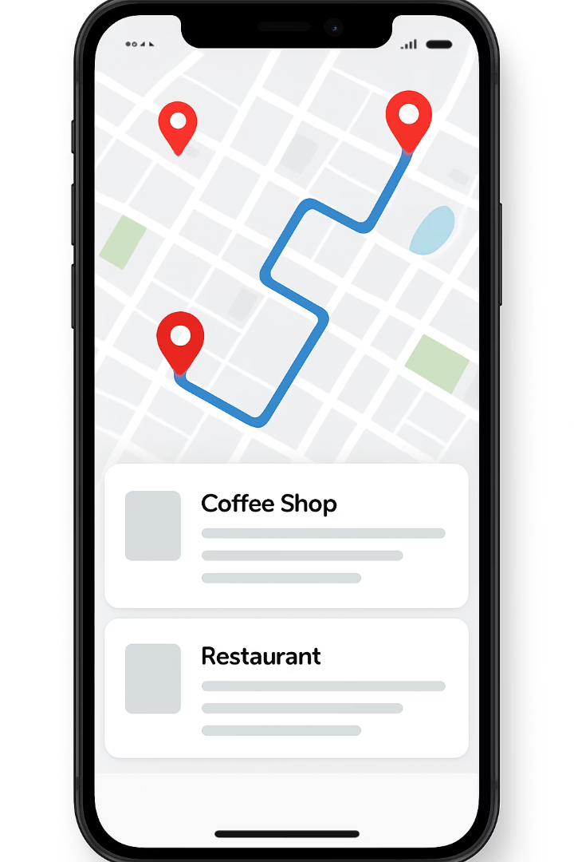
Introduction to Maps Integration in Expo
1.5B+
Active Users
Monthly active users of Google Maps globally
220+
Countries
Worldwide map coverage
25M+
Updates
Daily updates to map data
150M+
Businesses
Local businesses mapped globally
Maps integration enables your Expo application to incorporate location-based features, navigation capabilities, and spatial data visualization. This functionality has become essential for modern mobile applications across various industries, from retail and logistics to hospitality and gaming.

Slide 13
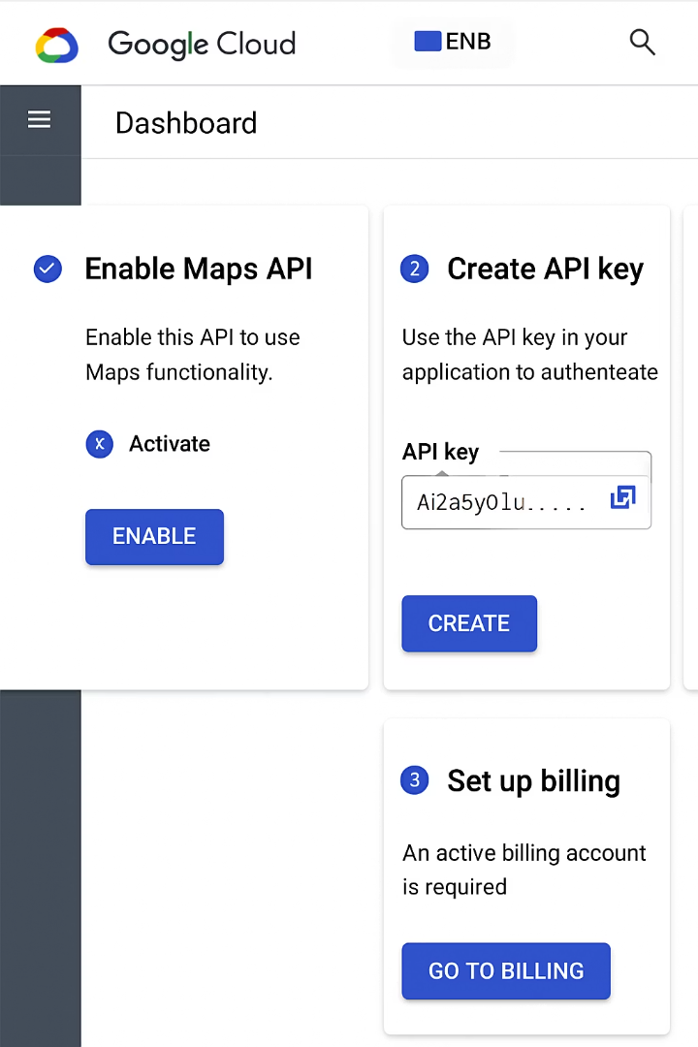




Setting Up Google Maps Platform for Your App
Create Google Cloud Project
Set up project in Google Cloud Console
Enable Billing
Configure payment method for API usage
Enable Maps API
Activate Maps, Places, and Geocoding APIs
Generate API Keys
Create restricted API keys for app use
Proper setup of your Google Maps Platform account is essential for secure and cost-effective map integration. When creating API keys, implement appropriate restrictions based on application ID, referrer URLs, and IP addresses to prevent unauthorized usage. The Google Cloud Console provides comprehensive usage analytics to monitor your application's map-related API calls.

Slide 14
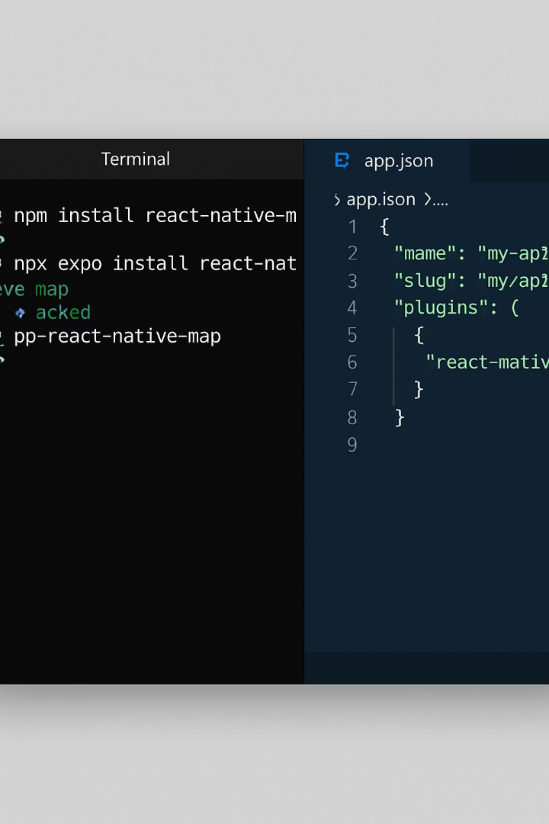
Installing React Native Maps in Expo
Install Package
npx expo install react-native-maps
Add the core maps package to your project dependencies
Update app.json
Configure with your Google Maps API key
"android": {
"config": {
"googleMaps": {
"apiKey": "YOUR_API_KEY"
}
}
},
"ios": {
"config": {
"googleMapsApiKey": "YOUR_API_KEY"
}
}
Rebuild Development Client
npx expo prebuild --clean
Regenerate native code with maps configuration
Verify Installation
Test basic map rendering in app

Slide 15
Creating Your First Map Component
Basic Map Implementation
const styles = StyleSheet.create({
container: {
flex: 1,
backgroundColor: '#fff',
alignItems: 'center',
justifyContent: 'center',
},
map: {
width: Dimensions.get('window').width,
height: Dimensions.get('window').height,
},
});
import React from 'react';
import { StyleSheet, View, Dimensions } from 'react-native';
import MapView, { PROVIDER_GOOGLE } from 'react-native-maps';
export default function BasicMap() {
return (
<View style={styles.container}>
<MapView
style={styles.map}
provider={PROVIDER_GOOGLE} // Remove this line if not using Google Maps
initialRegion={{
latitude: 21.0124167,
longitude: 105.5207831,
latitudeDelta: 0.0922,
longitudeDelta: 0.0421,
}}
/>
</View>
);
}
Key Implementation Details
Import MapView from react-native-maps
Set provider to PROVIDER_GOOGLE for consistent experience
Configure initialRegion with latitude/longitude coordinates
Set latitudeDelta and longitudeDelta for zoom level
Style the container and map appropriately
Account for device dimensions
Ensure parent container has appropriate dimensions
Test on both iOS and Android devices

Slide 16
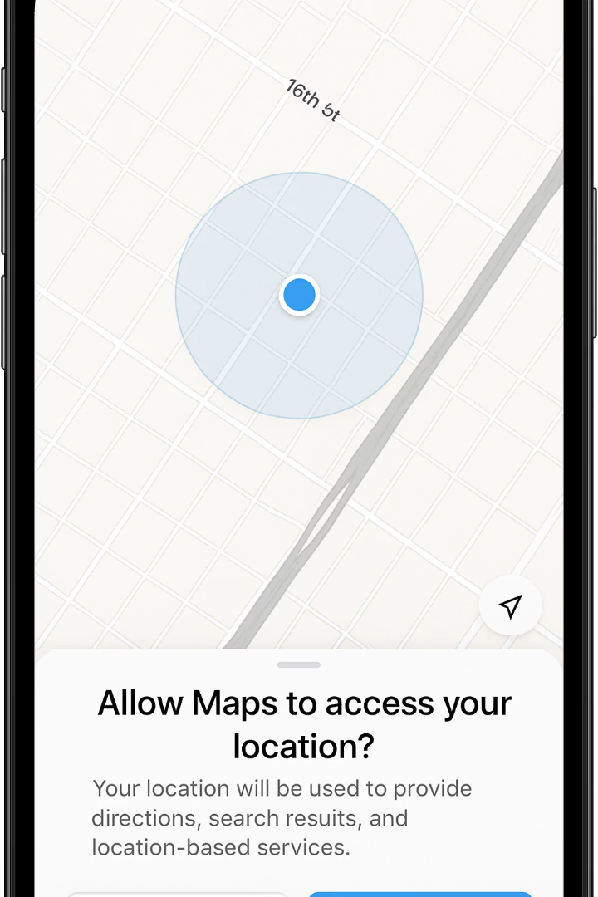
Implementing User Location Tracking
Request Location Permissions
Get Current Location
Install expo-location package
Use getCurrentPositionAsync()
Request foreground permissions
Configure accuracy options
Handle permission denial gracefully
Handle errors and timeout
Consider background location for tracking
Display loading state while fetching
Update Map View
Set showsUserLocation prop to true
Use followsUserLocation for tracking
Animate camera to user position
Add user location indicator
Implementing location tracking enhances user experience by providing contextual information based on their current position. This feature requires careful attention to privacy concerns and permission handling to comply with platform guidelines and user expectations.

Slide 17








Introduction to Image Picker Integration
Camera Access
Gallery Selection
Capture new photos directly within your app
Choose existing images from device storage
Front and rear camera support
Single or multiple selection
Flash control options
Thumbnail previews
Image quality settings
Album organization
Upload Integration
Image Manipulation
Send images to servers or cloud storage
Edit photos before final selection
Progress tracking
Cropping capabilities
Compression options
Basic filters
Batch processing
Rotation options

Slide 18
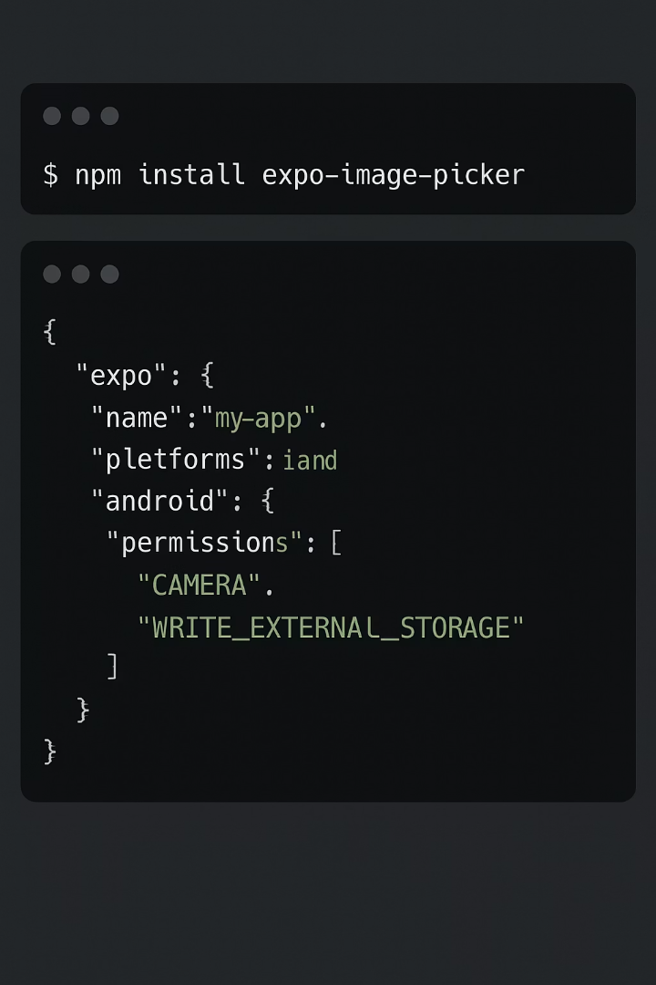
Installing expo-image-picker Package
Installation
npx expo install expo-image-picker
Add the official Expo module to your project dependencies
Permission Configuration
Update app.json with required permissions for camera and photo library access on both iOS and Android platforms
Import Package
import * as ImagePicker from 'expo-image-picker';
Import the package in components that will use image selection functionality
Verify Setup
Test basic image selection to ensure proper configuration and permission handling on both platforms

Slide 19
Implementing Basic Image Picker Functionality
import React, { useState } from 'react';
import { Button, Image, View, StyleSheet } from 'react-native';
import * as ImagePicker from 'expo-image-picker';
export default function ImagePickerExample() {
const [image, setImage] = useState(null);
const pickImage = async () => {
// Request permission
const { status } = await ImagePicker
.requestMediaLibraryPermissionsAsync();
if (status !== 'granted') {
alert('Sorry, we need camera roll permissions!');
return;
}
// Launch image library
let result = await ImagePicker
.launchImageLibraryAsync({
mediaTypes: ImagePicker.MediaTypeOptions.Images,//Filter for images, videos, or all media
allowsEditing: true,//Enable built-in editor
aspect: [4, 3], //Set aspect ratio for cropping
quality: 1,//Set compression level (0-1)
allowsMultipleSelection: true //Enable selecting multiple images
});
if (!result.canceled) {
setImage(result.assets[0].uri);
}
};
return(
<View style={styles.container}>
<Button title="Pick an image from camera roll" onPress={pickImage} />
{image && ( <Image source={{ uri: image }} style={styles.image} /> )}
</View>
);
const styles = StyleSheet.create({
container: {
flex: 1,
alignItems: 'center',
justifyContent: 'center',
},
image: {
width: 300,
height: 225,
marginTop: 20,
borderRadius: 8,
},
});
When implementing image picking functionality, always handle permissions gracefully with clear user messaging. Consider image size limits and compression settings to optimize for your use case, whether that's profile photos, document scanning, or media sharing.

Slide 20




Capturing Photos with Device Camera
Request Camera Permission
Get explicit user consent
Launch Camera Interface
Open native camera experience
Configure Camera Options
Set quality, flash, and front/back
Process Captured Image
Handle result and display preview
Camera integration provides a more direct capture experience compared to gallery selection. Using the launchCameraAsync method from expo-image-picker opens the device's native camera interface, allowing users to capture new photos specifically for your application's needs.
For more advanced camera control, consider using the expo-camera package, which provides real-time camera preview, video recording, barcode scanning, and face detection capabilities directly embedded in your application's UI rather than launching the system camera.

Slide 21





Handling Selected Images in Your App
Image Selection Result
Receive URI, dimensions, type, and other metadata from picker
Image Processing
Resize, compress, or transform images as needed for your application
Local Storage
Save processed images to app's file system for persistence
Remote Upload
Transfer images to backend service or cloud storage
Database Integration
Store image references and metadata in application database

Slide 22
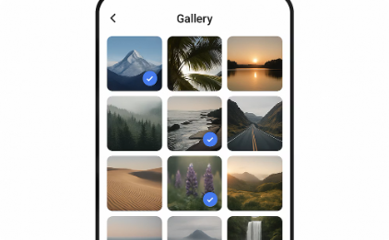

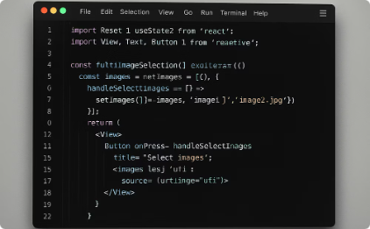
Creating a Multi-Image Selection Component
Selection Interface
Implement a grid-based selection UI that allows users to visually browse and select multiple images simultaneously. Include clear visual indicators for selected state and a counter showing the number of currently selected items.
Preview Management
Create a compact representation of selected images, typically as a horizontal scrolling list of thumbnails. This provides users with a summary of their selections while allowing for individual removal of items.
Implementation Details
Use useState to maintain an array of selected image URIs, implement ImagePicker with allowsMultipleSelection set to true, and create appropriate UI components for displaying and managing the collection of selected media.

Slide 23
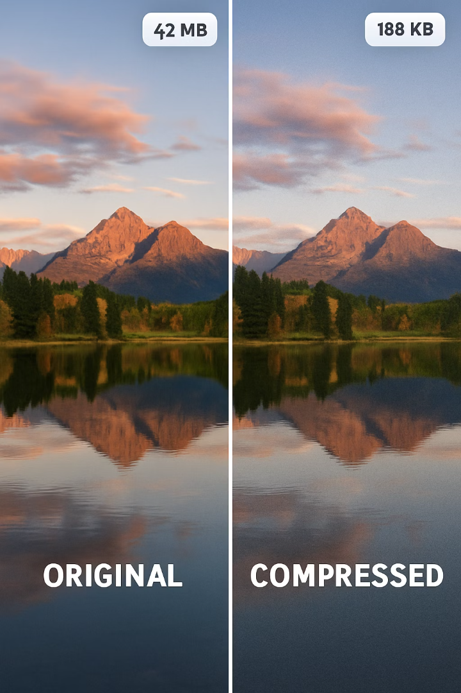
Image Compression and Optimization
Why Compress Images?
Compression Techniques
Reduce network bandwidth usage
Resize to target dimensions
Decrease storage requirements
Reduce quality (lossy compression)
Improve upload/download speed
Convert to efficient formats
Optimize memory consumption
Remove metadata when unnecessary
Implementation Tools
expo-image-manipulator
react-native-image-resizer
Quality parameter in ImagePicker
Server-side processing options
Effective image optimization balances visual quality with performance requirements. For user-generated content, implement adaptive compression strategies based on network conditions, device capabilities, and content type. Consider generating multiple resolutions for different use cases, such as thumbnails for lists and higher quality versions for detailed views.

Slide 24
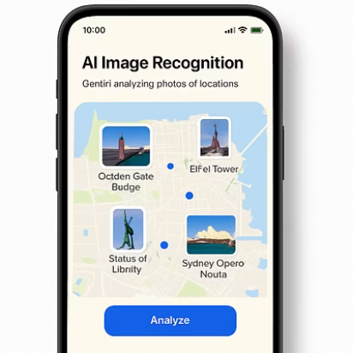
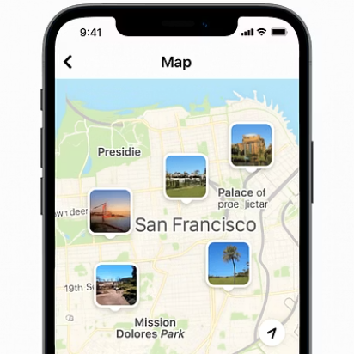
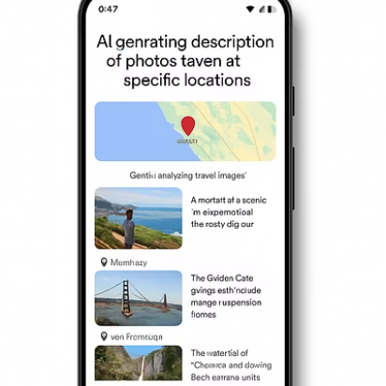
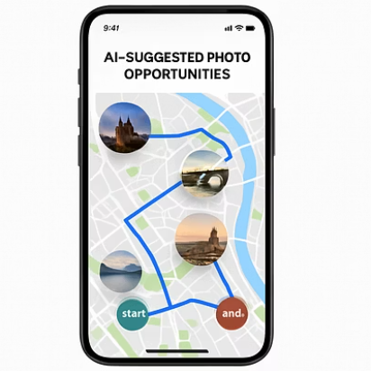
Integrating All Features: A Complete Example
By combining Gemini AI, Maps, and Image Picker into a cohesive application, you can create powerful experiences that exceed the sum of their parts. Consider implementing a travel companion app that allows users to capture photos at locations, uses Gemini to identify landmarks and generate descriptions, and displays these memories on a personalized map.
This integrated approach demonstrates how modern mobile applications can combine multiple sophisticated APIs to create intuitive, contextual experiences. Focus on creating smooth transitions between these features and maintaining consistent state management across the different integration points. As you develop your own applications, look for similar opportunities to create synergy between disparate capabilities.

